Slide 1
Passage of nerve messages >>>
Neurone structure
Nerve messages
Motor and Sensory nerves
http://www.bbc.co.uk/schools/gcsebitesize/science/aqa_pre_2011/human/thenervoussystemrev1.shtml

Slide 2
Neuron structure

Slide 3
Myelinated Neurones
The axons of many neurones are encased in a fatty myelin sheath.
Babies are born with a very thin sheath and are unable to co-ordinate movement
Where the sheath meets the next, the axon is unprotected.

Slide 4
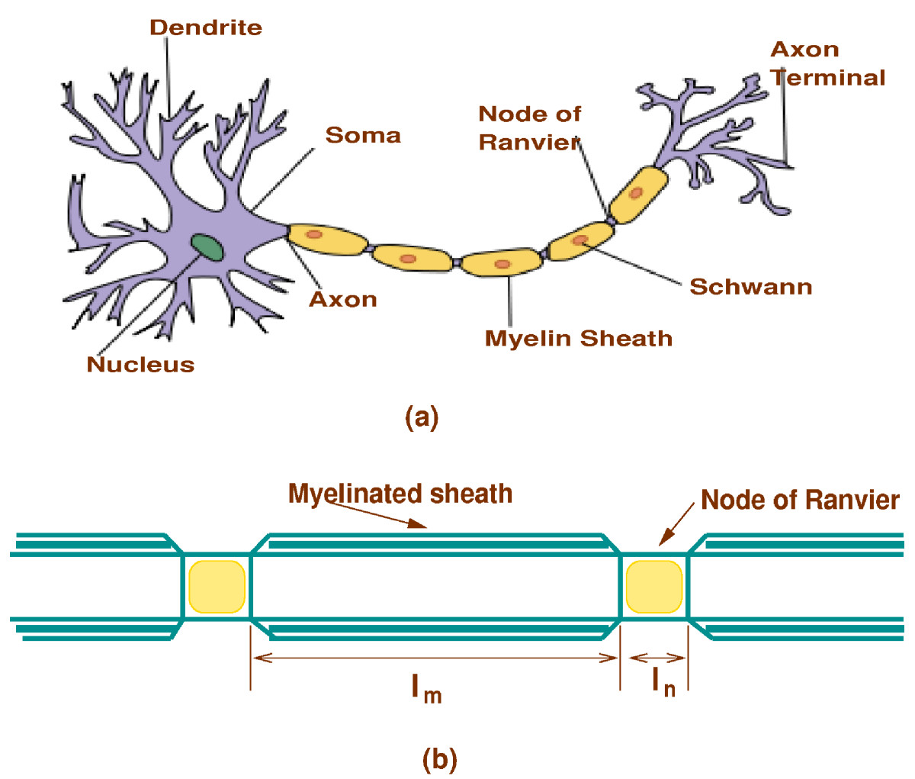
Neuron
Structure

Slide 5
Nerve impulses
Neurones send messages electrochemically – this means that chemicals cause an electrical impulse.
Chemicals in the body are ‘electrically charged’ when they have an electrical charge, they are called ions.

Slide 6
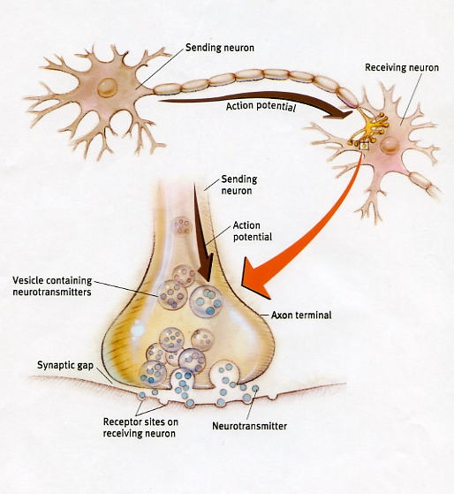

Slide 7
Types of nerves…
Sensory nerves send messages to the brain and generally connect to the brain through the spinal cord inside your backbone.
Motor nerves carry messages back from the brain to all the muscles and glands in your body

Slide 8
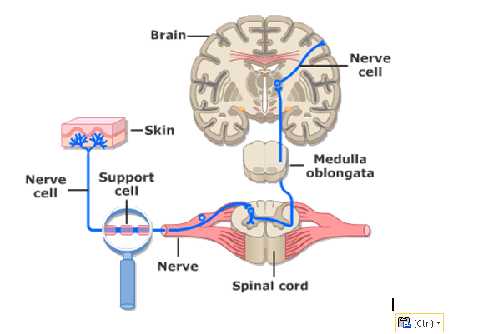
Sensory nerve

Slide 9
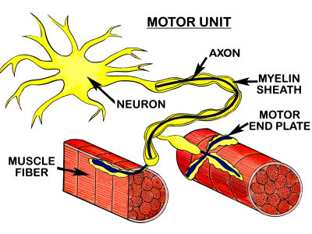
Motor nerve

Slide 10
Message direction
Afferent Neurones - Also known as sensory neurones, these are specialised to send impulses towards the CNS away from the peripheral system
Efferent Neurones - These nerve cells carry signals from the CNS to the cells in the peripheral system

Slide 11
To aid understanding..
http://www.youtube.com/watch?v=iBnGeDzTYD4
Apologies; American accent warning
http://www.youtube.com/watch?v=XgIaAs_ONG4
This one is a fun explanation!
http://www.youtube.com/watch?v=owZNPmxZPeU

